Slide 1
What is Help Connect?

Slide 2





How does the lifesaving service for motorcycles work
What is Help Connect
Automatic accident detection
24/7 international emergency call handling
Immediate rescue aid on site

Slide 3
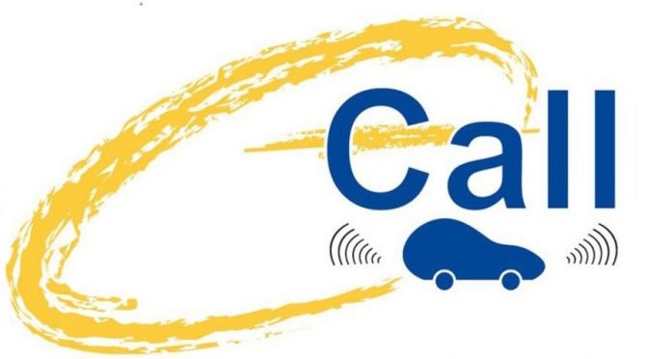





How does the lifesaving service for motorcycles work
What is Help Connect
Automatic accident detection
24/7 international emergency call handling
Immediate rescue aid on site
Standard: eCall
New: Help Connect for Cross-Domain Safety
…

Slide 4



How does the lifesaving service for motorcycles work
What is Help Connect
Rescue mission
Immediate rescue aid on site
Accident or medical emergency
24/7 international emergency call handling
Emergency call processing and assistance

Slide 5


How does the lifesaving service for motorcycles work
What is Help Connect
Rescue mission
Immediate rescue aid on site
Emergency contacts, First responder community
Accident or medical emergency
24/7 international emergency call handling
Emergency call processing and assistance
Further information
Information for self-help

Slide 6



How does the lifesaving service for motorcycles work
What is Help Connect
Rescue mission
Immediate rescue aid on site
Emergency contacts, First responder community
Best possible data
User profile
Location & precision
Context information
Best possible co-ordinated help
Bi-lingual personnel & context-specific assistance
Multilayered emergency assistance service
Accident or medical emergency
24/7 international emergency call handling
Emergency call processing and assistance
Further information
Information for self-help

Slide 7


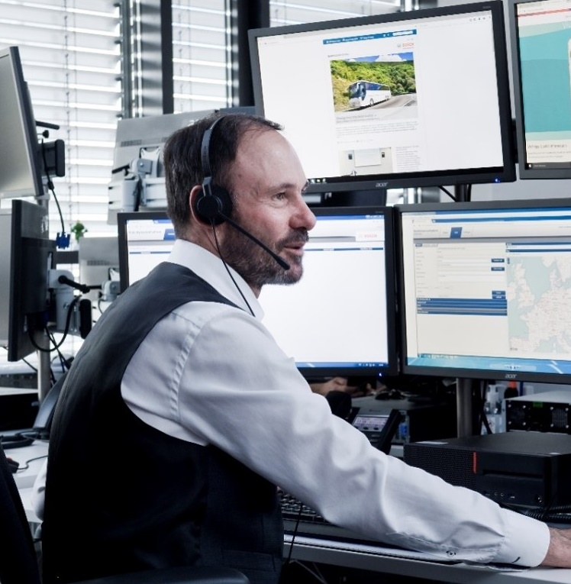




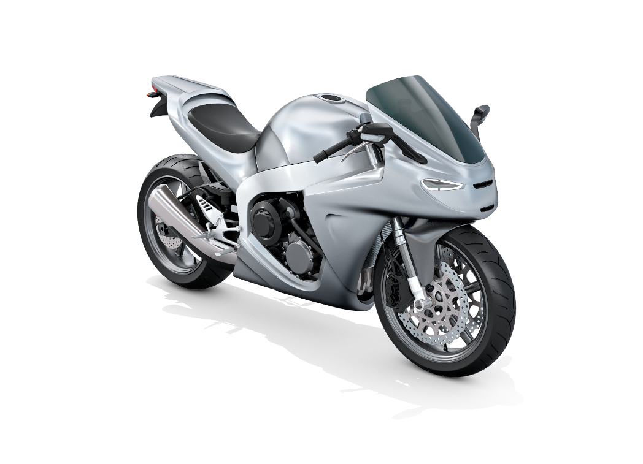
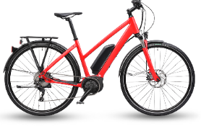

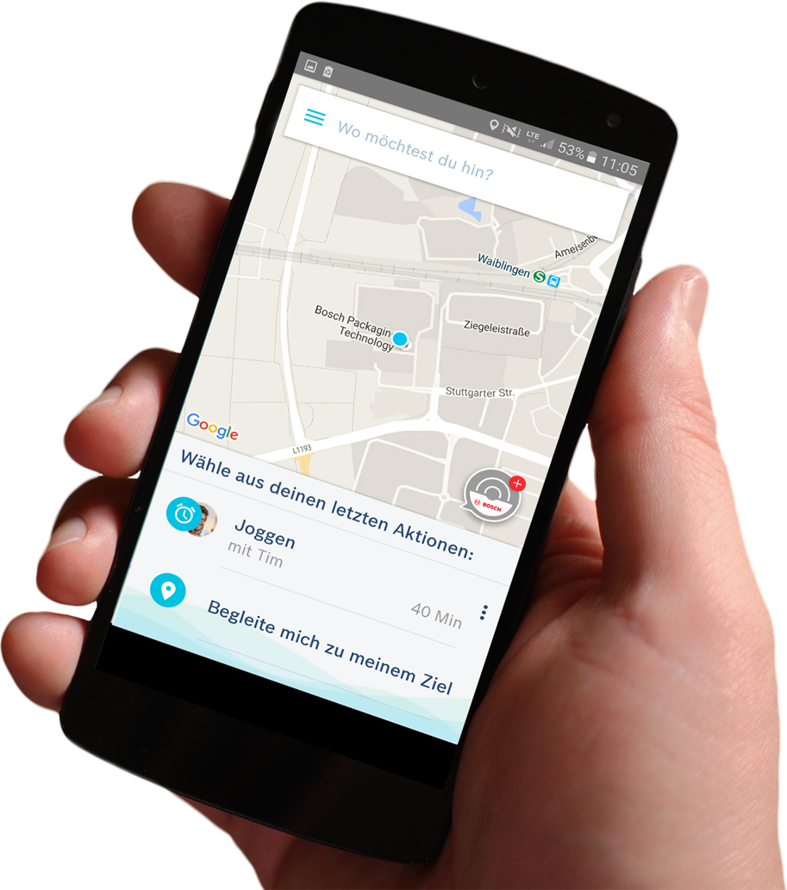
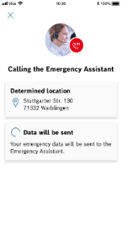
One-stop service solution, one price, many devices and brands
Jointly we create a Personal Safety Ecosystem
Help Connect
Connected home
Connected bike
Connected car
Connected motorcycle
Notes:
Input
So far, the lifesaving function of automatic emergency calls in case of an accident was reserved to cars. Since 2018 the eCall is a must-have features in new cars in the region of the European union. Why? Getting immediate information about a collision and pinpointing its exact location can cut the time it takes for emergency services to arrive on the scene by up to half. The question we asked ourselves is? Why should this solution be limited to cars only? You´ve heard and seen before: there are more vulnerable road users, and there are even more contexts where emergency calls can make sense and can help to save lifes.
Help Connect from Bosch.IO makes the Bosch claim Invented for Life approachable for the Internet of Things. We reinvent the traditional emergency call with our software & service solution, which can automatically detect crashes and organize help in emergencies. Any connected product – a smartphone, car, bike, motorcycle or smart home – can be used to transmit lifesaving information. In many domains such a solution does either not exist at all or is only provided from single product manufacturers for their own portfolio. Thus, the novelty of Help Connect is to introduce an easy to integrate and flexible emergency call solution, that can be integrated with existing products by various B2B partners from multiple domains. This leads to faster first aid for the first time ever for some connected devices. Thereby we built up a cross-domain personal safety ecosystem for end users, being available for different use cases with different partners and brands – on the road, and in the future also at home.
The idea is that customers sign up once: With one Bosch ID, they pay once a year or a month and can then use the service during different adventures of life!
Tonspur:
Klassisch: 112 → eCall v. Mercedes → Help Connect für das IoT
Erweiterung des Modells auf das Internet of Things
Schritt 1: smarter mobiler Notruf auf Smartphone
Schritt 2: integrierte, aber damit auch breite, Umsetzung in den Domänen mit Partnern, am Bsp. RB BUs
Schritt 3: Nutzung des RB-Endnutzerzugangs für die Rolle des Ökosystem-Orchestrators
Vorteil für Endnutzer: Single Sign-on, Single pay, aber Service ist in versch. Produkten nutzbar

Slide 8
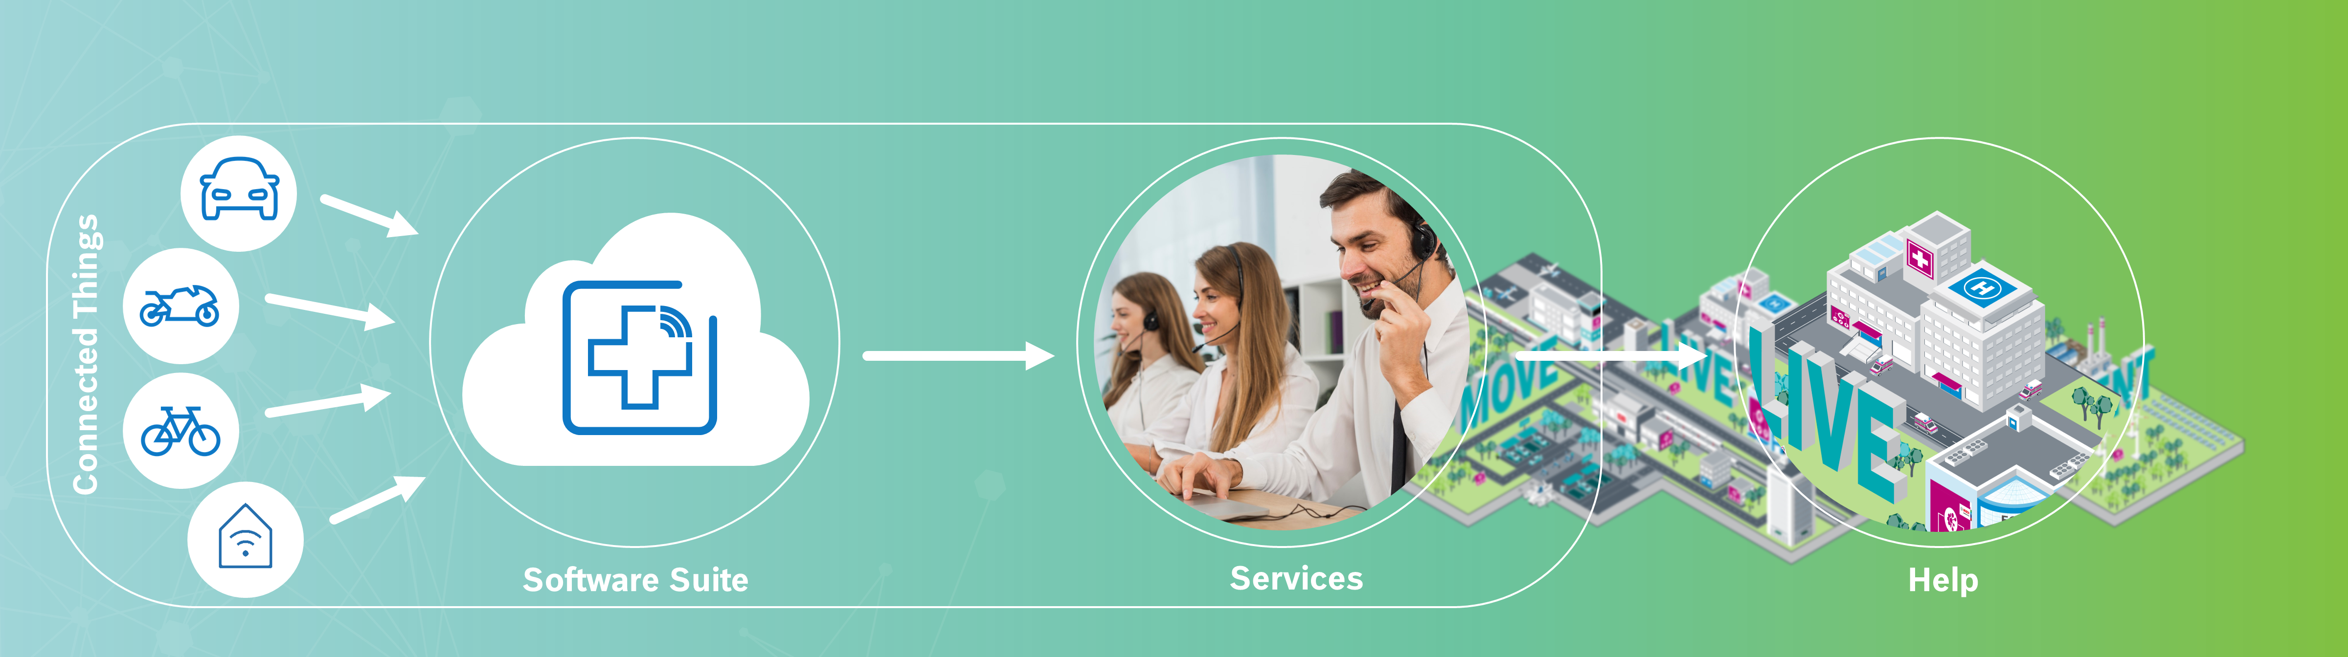




Our partners provide connected things
With our software & service suite we turn them into lifesavers
Help Connect Ecosystem
Help Connect enables an easy-to-integrate safety solution for B2B partners via SDKs (Android, iOS) and API into connected things and apps. The end-user receives faster first aid via his IoT device enriched with Help Connect from Bosch.

Slide 9
Summary of today’s offer, value proposition and USPs
Our core product is Help Connect
USPs
One cross-domain service which is accessible from connected devices & apps
24/7 professional help everywhere¹ and at any time
Better help: Important health & context data is available for the first responders
Smart emergency detection, analysis and intervention based on real-time data
Help Connect – the smart emergency call for the IoT
Meaningful We enable our B2B partners to differentiate their products with a proven safety solution
Easy-to-integrate A fully developed IT and service infrastructure that allows easy (API or SDK) integration
Affordable and for all scales Leveraging Bosch eCall field experience and synergies from platform and resource sharing
Enables service business Includes an E2E payment system including user data, subscription and recurring payments handling
Automatic detection of emergencies via products, sensors and smart algorithms
Automatic call setup to Help Connect Assistants incl. transfer of user, device, location & severity data
Organization of rescue aid on site with professional services (‘112’), complemented via personal community support
Enabling personal safety across different products and domains (car, motorbike, e-bike/ bike, home) with one central user access and safe data storage
OFFERING
VALUE
1) Available today for German users in 11 EU countries (global rollout possible)

Slide 10


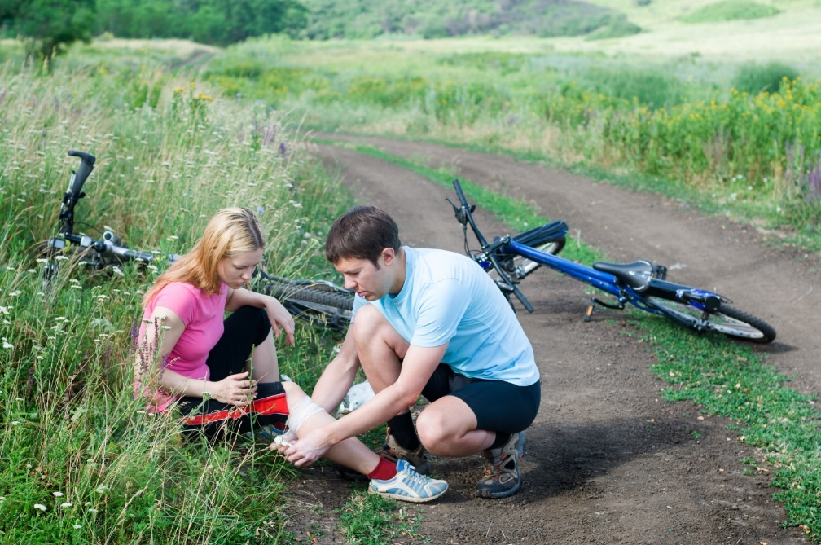

Our goal is fast, comprehensive, targeted and better first aid
Further differentiation via technological USPs
Automatic & smart
emergency detection
Crash and fall detection for cars, e-bikes, motorbikes and pedestrians
Calculation of severity levels and recommended actions
Ecosystem of products
from different domains
One IoT platform to connect multiple devices with the same emergency service
Storage and centralized access to sensitive data
Integration of
personal communities
Informing emergency contacts via service agents or directly via user interface
Receiving local support by nearby first responders
AI / voice bot based
service delivery
Assessing events with 24/7 service operators and organizing local support
Ontology & smart voice bot for user interaction
We are looking for strong partners to support our mission towards faster first aid. Thus we are highly interested in your perspectives and ideas to further differentiate and scale Help Connect.

Slide 11



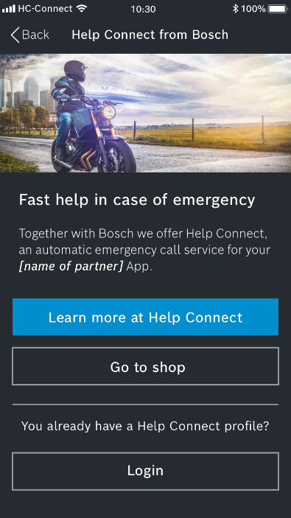


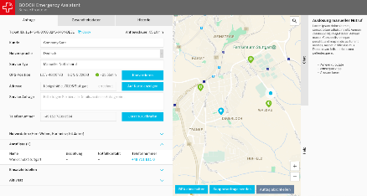







Easy integration into your product with fast time to market
Adding building blocks
Smart Things
Crash Detection
Partner App with integrated Help Connect SDK
Help Connect SW & Service Suite
From Bosch (IO, EB, 2WP)
or partner
Verbal information User profile Context Contacts

Slide 12
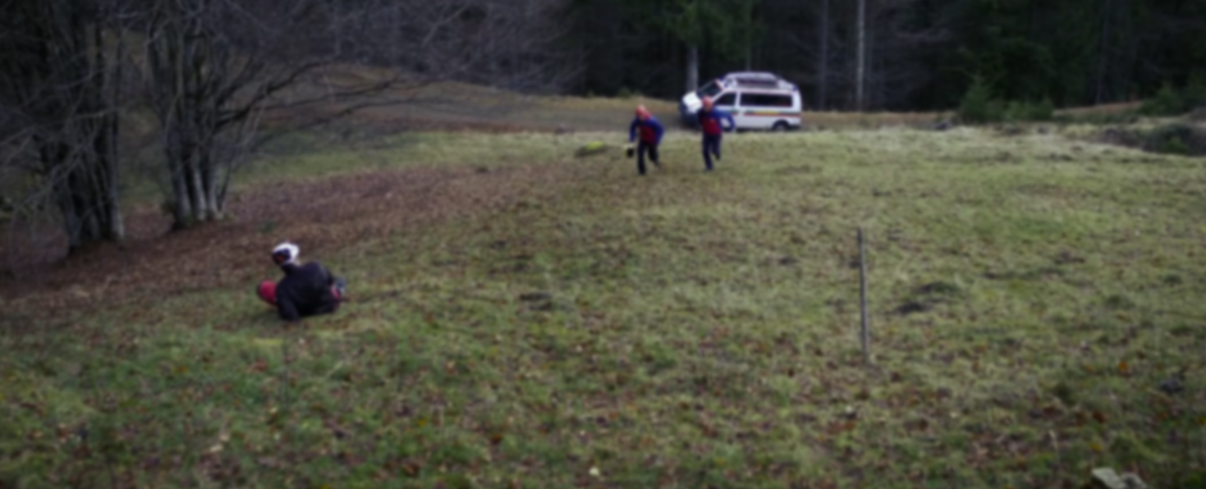

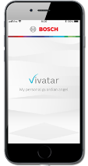



Device and user data is automatically transferred and assessed
Exemplary workflow: emergency handling end-to-end
Local help
Information within an emergency event
Public rescue services
User profile
Location & precision
Emergency contact, communities
Context information
Accident or medical emergency
Emergency call processing and assistance
Information for self-help
Further information

Slide 13

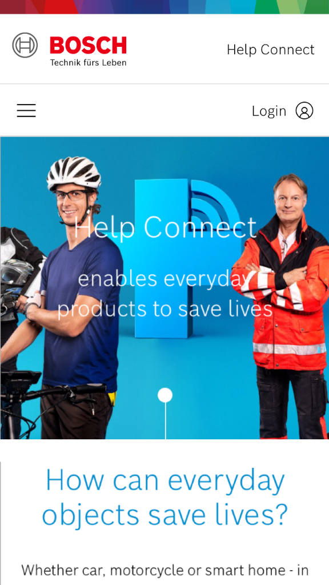
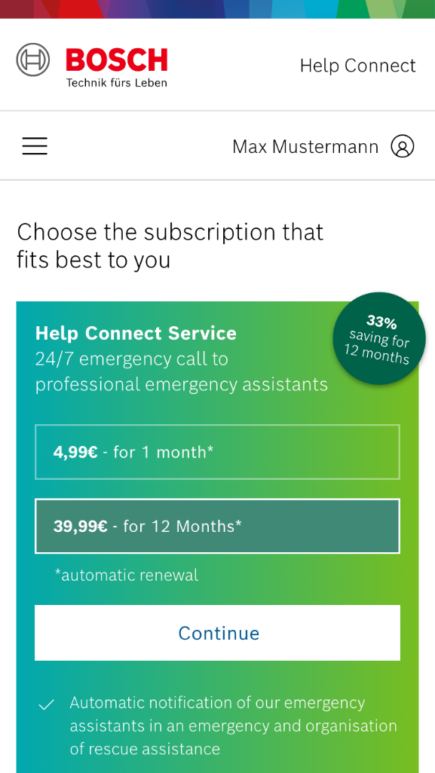
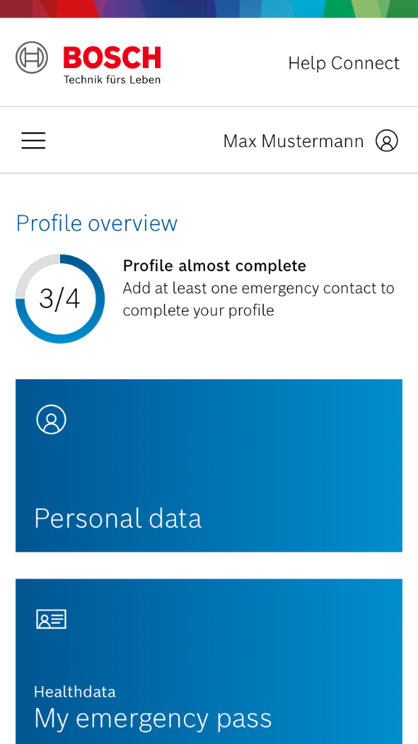
User Mgt. & payment system are optional parts of the solution¹
Partner device/app with Help Connect integrated
In-app-view @ Partner app
1
Help Connect Website
2
Help Connect Shop
3
Help Connect Profile
Help Connect Ecosystem
1
2
3
¹ Alternatively user management and eCommerce handling from partner, and matching with Bosch ID or OpenID Connect.

Slide 14
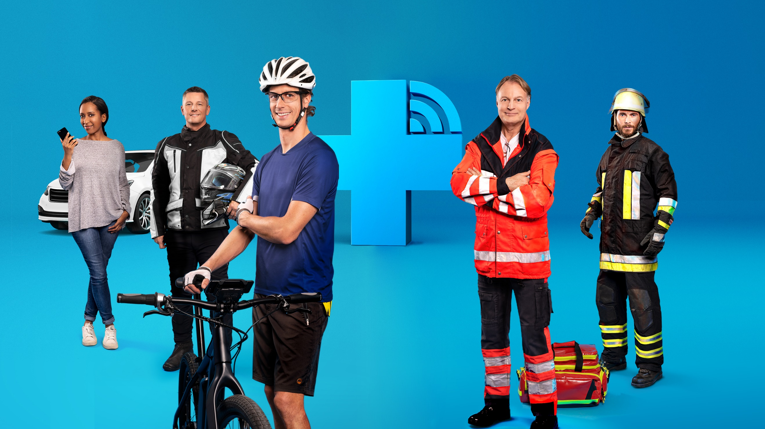
Help Connect
Turns your products into lifesavers
Notes:
Help Connect – Macht Deine Produkte zu Lebensrettern
Eine Situation, wie sie jeden treffen kann: Man ist alleine unterwegs - auf dem Fahrrad, dem Motorrad oder im Auto - und gerät in einen Unfall. Aber was passiert, wenn man selbst nicht mehr in der Lage ist, Hilfe zu rufen?
Im Notfall können Sensoren in deinen Produkten Unfälle und Notlagen automatisch erkennen und Hilfe alarmieren. Help Connect kann dir so rund um die Uhr in unterschiedlichen Lebenslagen schnelle Hilfe organisieren - auch wenn du es selbst nicht mehr kannst. Mit Help Connect steht dir dafür rund um die Uhr ein professioneller Notrufservice von Bosch zur Seite, der direkt die lokalen Rettungskräfte informieren kann. Blitzschnell übertragen sie im Notfall lebensrettende Informationen zum Geschehen, so dass Rettungskräfte an den Unfallstandort geschickt werden. So wird sichergestellt, dass schnell und gezielt Hilfe organisiert werden kann.

